Slide 1
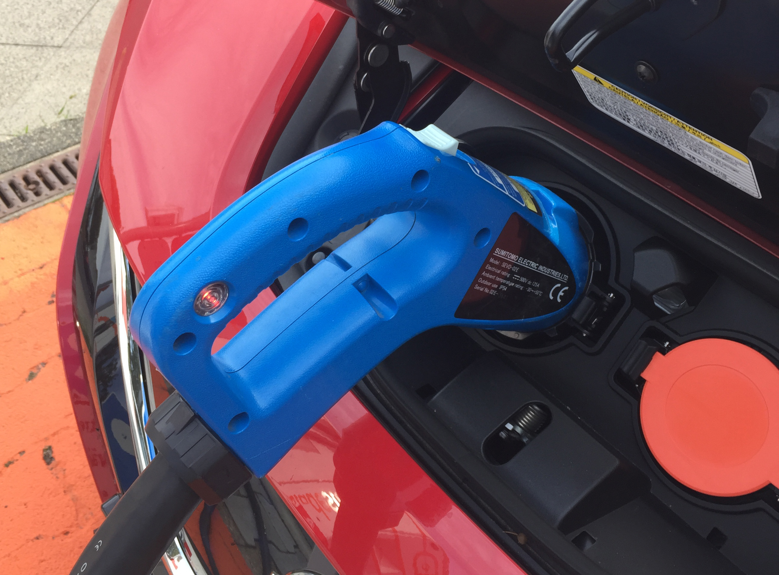

European Market of Battery Electric Vehicles declines in 2024
The market of new BEVs, cars which run exclusively on an electric engine powered by a battery, declined slightly in Europe in 2024.
25,783 less BEVs were registered according to numbers provided by ACEA, the European Automobile Manufacturers' Association,
The total market size for new cars grew 1% with close to 13 million new cars registered in 2024.

Slide 2
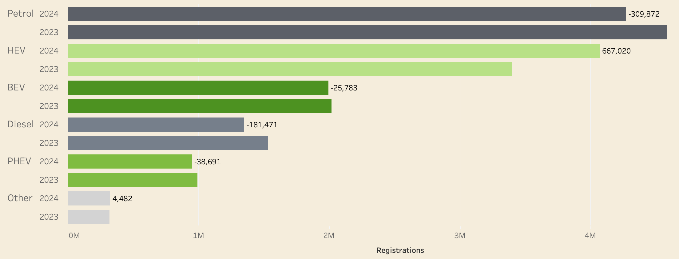
Hybrids become very popular, Fossil Powered Engines loose terrain
The number of registered hybrid cars in Europe increased with 20% to over 4 million vehicles in 2024. However, the number of Plug-in Hybrids declined. Newly registered vehicles powered by fossil fuels (diesel and petrol) decreased with nearly 500,000 vehicles compared to 2023.
Source: ACEA

Slide 3

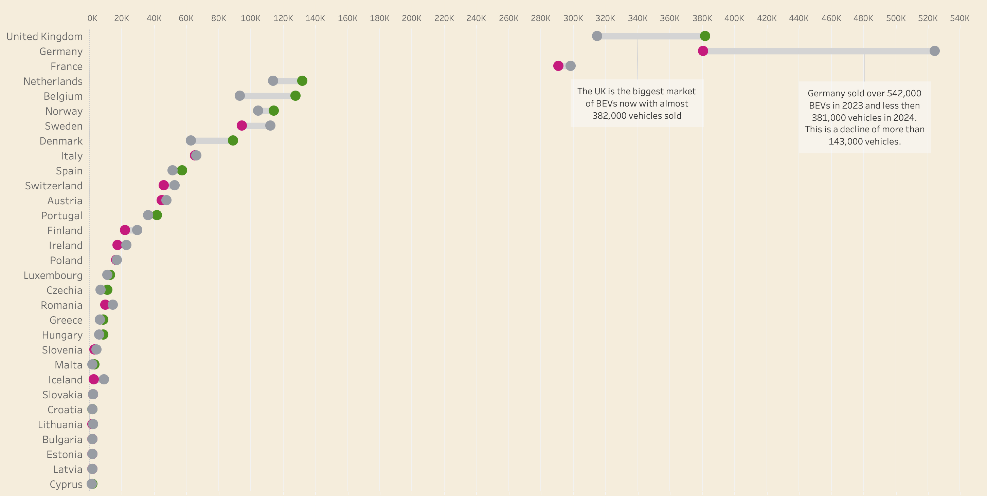
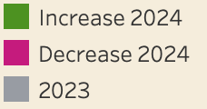
BEV Sales collapsed in Germany...
The German market is the largest contributor to the lower BEV sales in 2024 as almost 144,000 fully electric vehicles less were registered in 2024. The United Kingdom on the contrary, witnessed a strong increase in BEV sales. It took over the number 1 BEV position of Germany with almost 382,000 BEVs sold, an increase of over 67,000 vehicles compared to 2023.
Source: ACEA

Slide 4
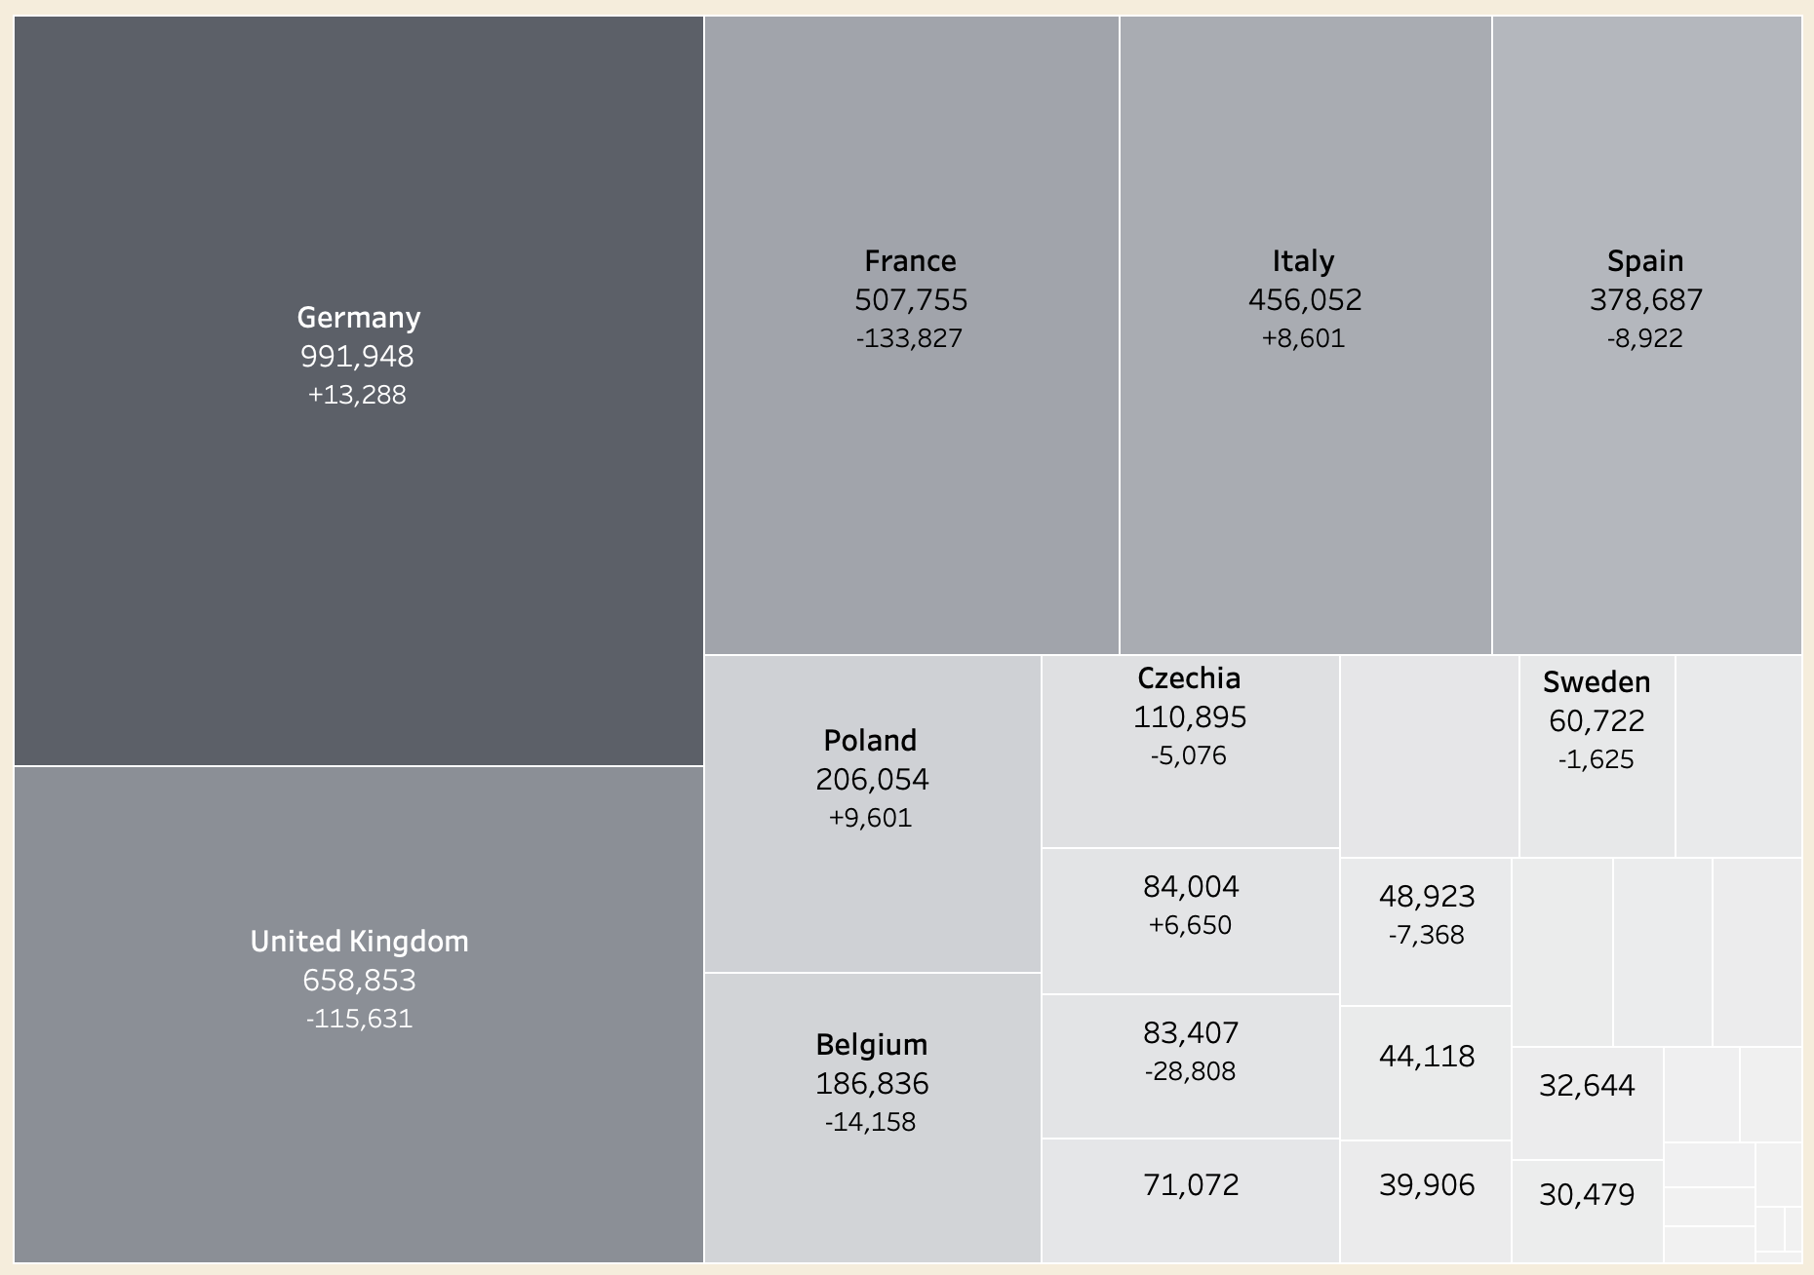
...but Germans remains the biggest petrol heads
Most major countries in terms of petrol powered vehicles saw these numbers drop significantly. Germany, Austria and Italy saw a small increase.
Source: ACEA

Slide 5
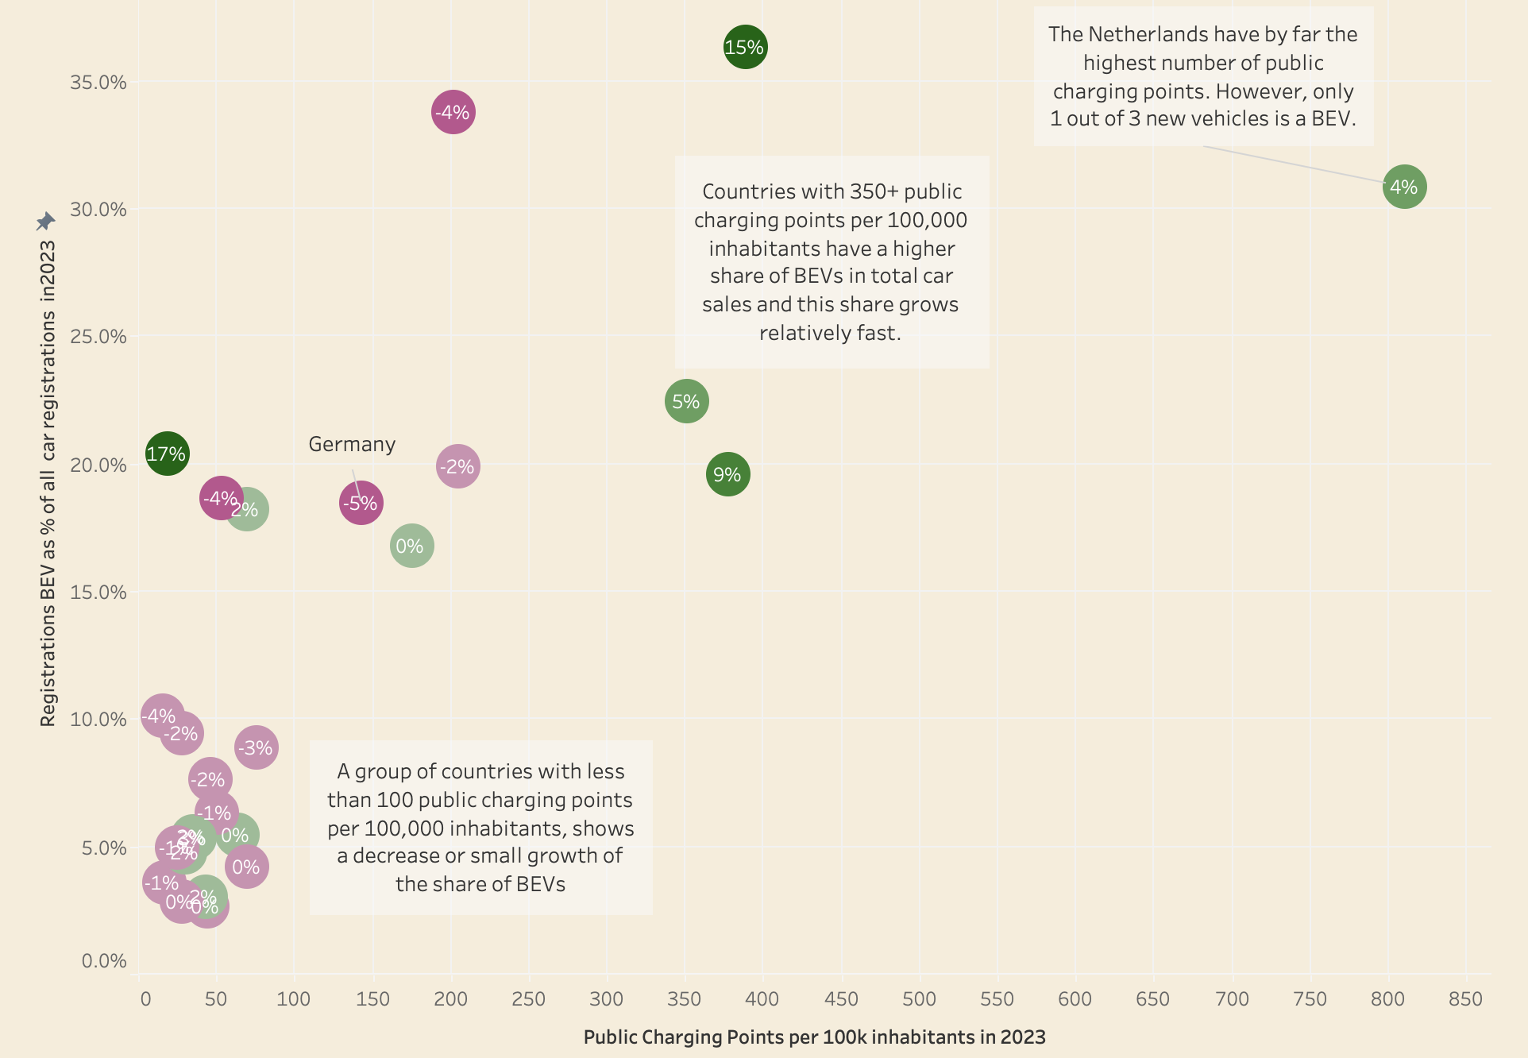
Charging infrastructures influences BEV sales
EU Countries which a better charging infrastructure for electric vehicles, seem to have a higher share of BEV sales.
The visual gives a rough indication for this. It shows the number of public charging points per 100,000 inhabitants in each EU-country in 2023 and compares it with the percentage of BEVs sales as a total of all sales in the same year.
The growth of the BEV share in 2024 in percent points is shown inside each dot. This indicates that a relatively small number of public charging points results in a small increase or decrease in BEV sales whereas a relative high number results in higher BEV growth.
However charging infrastructure isn't the only factor at play in the European Union. The Netherlands has a very high number of public charging points, but only 1 out of 3 new vehicles is a BEV and BEV growth is modest. Other factors like car prices of BEVs, consumer preferences and governmental policies likely influence the outcome as well.
Source: ACEA, Eurostat

Slide 6
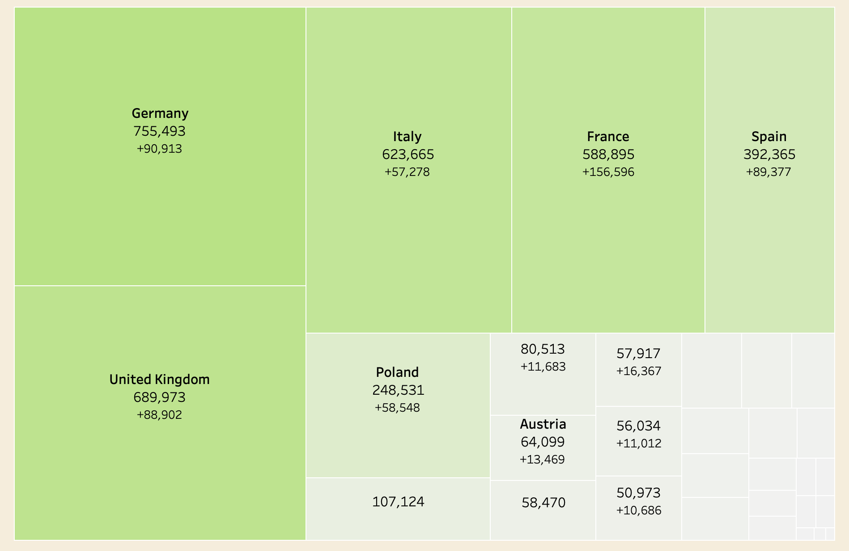
Hybrid sales grow fast all over Europe
All major car countries show a strong increase of hybrids sales (HEV). Germany, France and the UK each show an increase of HEVs sales of over 100,000 in 2024 relative to 2023.
Source: ACEA

Slide 7
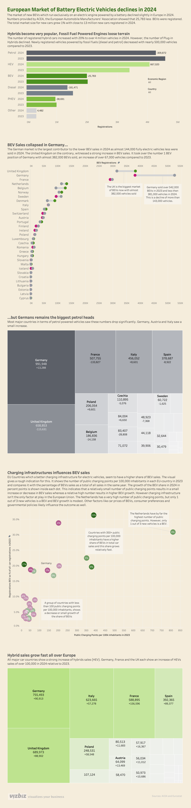
Thanks for reading!
An interactive infographics with the visuals is available on Tableau Public
Research and visuals: Bart Jutte
Please like and share if you enjoyed this presentation

